Slide 1
NEW SEMESTER BRIEFING
FACULTY OF SOCIAL SCIENCES AND HUMANITIES
KUALA LUMPUR
Notes:
https://unsplash.com/photos/Kt8eGw8_S8Y

Slide 2
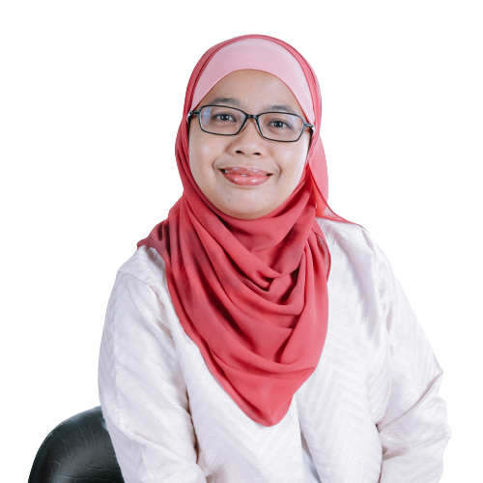
DR ZUHANA MOHAMED ZIN
DIRECTOR, FSSHKL
Expertise
Critical Literacy, L2 Literacy, Applied Linguistics, TESL, Second Language Acquisition, Language Education
Notes:
https://www.google.com/search?safe=strict&tbs=isz:l&tbm=isch&q=BUSINESSMAN+PNG&spell=1&sa=X&ved=0ahUKEwiZ2J_Bm8rjAhVSAXIKHVruA0QQBQhpKAA&biw=2560&bih=888&dpr=1#imgrc=Rn8EkHZqe8hOTM:

Slide 3
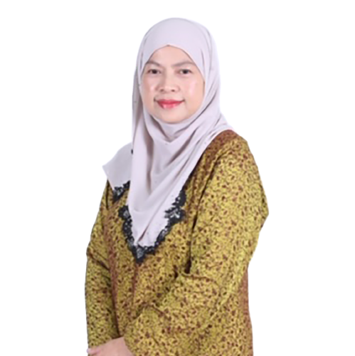
DR NOR LIZA HAJI ALI
DEPUTY DIRECTOR, LA FSSHKL
Expertise
Language Policy and Planning, English Curriculum, and Tertiary Literacy
Notes:
https://www.google.com/search?safe=strict&tbs=isz:l&tbm=isch&q=BUSINESSMAN+PNG&spell=1&sa=X&ved=0ahUKEwiZ2J_Bm8rjAhVSAXIKHVruA0QQBQhpKAA&biw=2560&bih=888&dpr=1#imgrc=Rn8EkHZqe8hOTM:

Slide 4
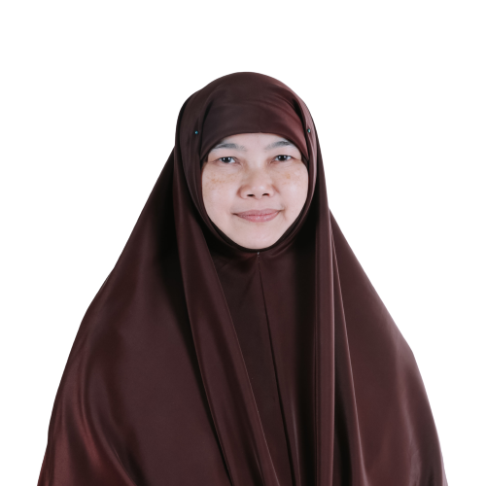
ASSOC. PROF. DR SARIMAH SHAMSUDIN
SENIOR LECTURER, FSSHKL
Expertise
Computer-Assisted Language Learning (CALL), Computer-Mediated Communication (CMC), Corpus Linguistics, ESP, ELT, Discourse Analysis, Vocabulary, Genre Analysis, Error Analysis and Task-based Language Learning and Teaching
Notes:
https://www.google.com/search?safe=strict&tbs=isz:l&tbm=isch&q=BUSINESSMAN+PNG&spell=1&sa=X&ved=0ahUKEwiZ2J_Bm8rjAhVSAXIKHVruA0QQBQhpKAA&biw=2560&bih=888&dpr=1#imgrc=Rn8EkHZqe8hOTM:

Slide 5
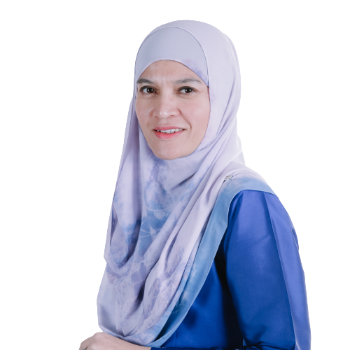
ASSOC. PROF. DR MARLIA PUTEH
SENIOR LECTURER, FSSHKL
Expertise
English Language Studies, Electronic Learning, Engineering Education, Higher Education Policy Research, Qualitative Research Methods
Notes:
https://www.google.com/search?safe=strict&tbs=isz:l&tbm=isch&q=BUSINESSMAN+PNG&spell=1&sa=X&ved=0ahUKEwiZ2J_Bm8rjAhVSAXIKHVruA0QQBQhpKAA&biw=2560&bih=888&dpr=1#imgrc=Rn8EkHZqe8hOTM:

Slide 6
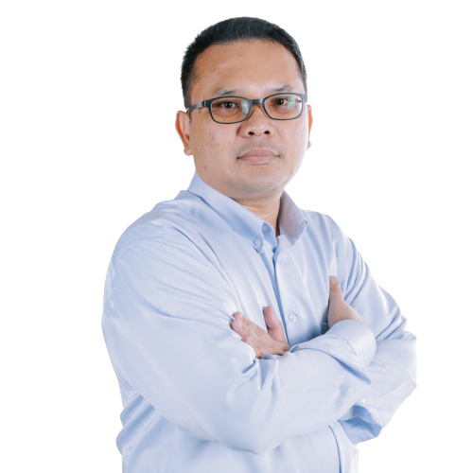
DR HARMI IZZUAN BAHARUM
LA POSTGRADUATE PROGRAMME COORDINATOR, FSSHKL
Expertise
Language education and technology, Computer assisted language learning, Technology acceptance and adoption of Management information systems
Notes:
https://www.google.com/search?safe=strict&tbs=isz:l&tbm=isch&q=BUSINESSMAN+PNG&spell=1&sa=X&ved=0ahUKEwiZ2J_Bm8rjAhVSAXIKHVruA0QQBQhpKAA&biw=2560&bih=888&dpr=1#imgrc=Rn8EkHZqe8hOTM:

Slide 7
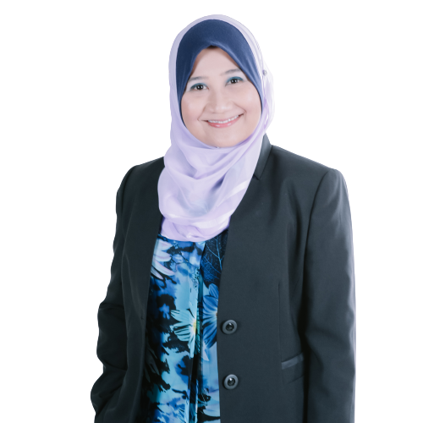
DR NURHASMIZA ABU HASAN SAZALLI
POSTGRADUATE PROGRAMME (TESL) COORDINATOR
Expertise
Mobile Language Learning, Design Based Research, Second Language Acquisition, Cross-cultural Communication
Notes:
https://www.google.com/search?safe=strict&tbs=isz:l&tbm=isch&q=BUSINESSMAN+PNG&spell=1&sa=X&ved=0ahUKEwiZ2J_Bm8rjAhVSAXIKHVruA0QQBQhpKAA&biw=2560&bih=888&dpr=1#imgrc=Rn8EkHZqe8hOTM:

Slide 8
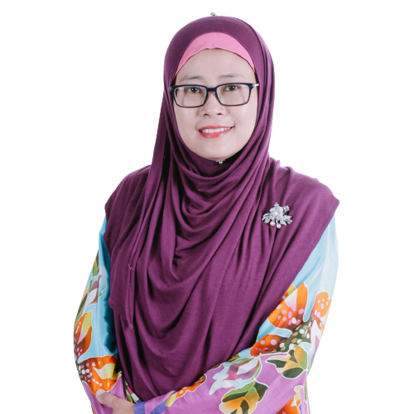
DR SERIAZNITA
MAT SAID
UNDERGRADUATE PROGRAMME COORDINATOR, FSSHKL
Expertise
TESL, Language Curriculum Planning, Young Adult Literature, English For Occupational Purposes, English For Academic Purposes
Notes:
https://www.google.com/search?safe=strict&tbs=isz:l&tbm=isch&q=BUSINESSMAN+PNG&spell=1&sa=X&ved=0ahUKEwiZ2J_Bm8rjAhVSAXIKHVruA0QQBQhpKAA&biw=2560&bih=888&dpr=1#imgrc=Rn8EkHZqe8hOTM:

Slide 9
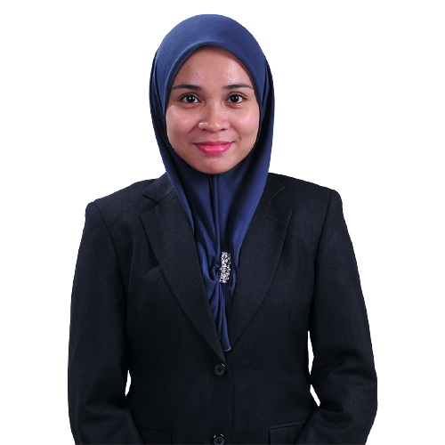
DR WAN FARAH WANI WAN FAKHRUDDIN
SENIOR LECTURER, FSSHKL
Expertise
Systemic Functional Linguistics, Applied Linguistics, ESP, Genre Studies
Notes:
https://www.google.com/search?safe=strict&tbs=isz:l&tbm=isch&q=BUSINESSMAN+PNG&spell=1&sa=X&ved=0ahUKEwiZ2J_Bm8rjAhVSAXIKHVruA0QQBQhpKAA&biw=2560&bih=888&dpr=1#imgrc=Rn8EkHZqe8hOTM:

Slide 10
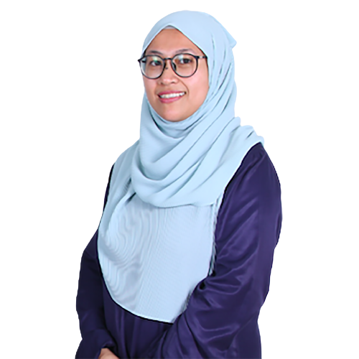
DR WAN NUR ASYURA WAN ADNAN
SENIOR LECTURER, FSSHKL
Expertise
Applied linguistics, Health Communication, Media Discourse
Notes:
https://www.google.com/search?safe=strict&tbs=isz:l&tbm=isch&q=BUSINESSMAN+PNG&spell=1&sa=X&ved=0ahUKEwiZ2J_Bm8rjAhVSAXIKHVruA0QQBQhpKAA&biw=2560&bih=888&dpr=1#imgrc=Rn8EkHZqe8hOTM:

Slide 11
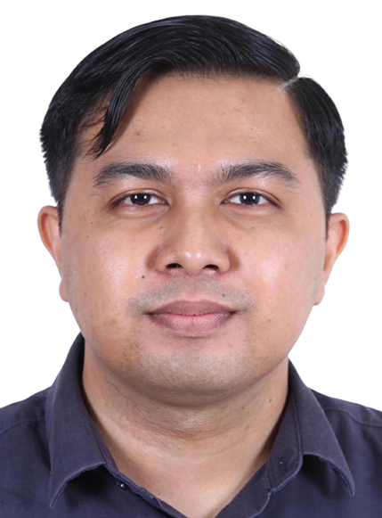
Mr. Muhammad Nadzrin bin Abdullah Mohmmad Suhaimi
Assistant Administrative Officer
nadzrin@utm.my
In charge of:
Supervisor/ Co-SV appointment
Proposal submission
Viva submission
Thesis submission/ Graduation/ Deferment
Notes:
https://www.google.com/search?safe=strict&tbs=isz:l&tbm=isch&q=BUSINESSMAN+PNG&spell=1&sa=X&ved=0ahUKEwiZ2J_Bm8rjAhVSAXIKHVruA0QQBQhpKAA&biw=2560&bih=888&dpr=1#imgrc=Rn8EkHZqe8hOTM:

Slide 12
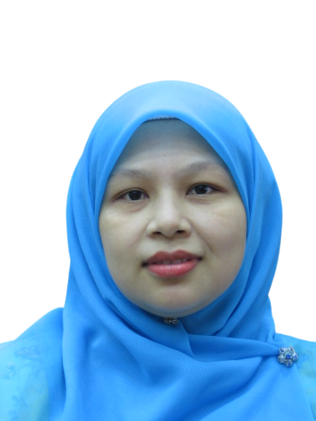
Mdm Roshaiza Ghazali
Assistant Administrative Officer
roshaiza.kl@utm.my
In charge of:
Course registration
Research code registration
Notes:
https://www.google.com/search?safe=strict&tbs=isz:l&tbm=isch&q=BUSINESSMAN+PNG&spell=1&sa=X&ved=0ahUKEwiZ2J_Bm8rjAhVSAXIKHVruA0QQBQhpKAA&biw=2560&bih=888&dpr=1#imgrc=Rn8EkHZqe8hOTM:

Slide 13
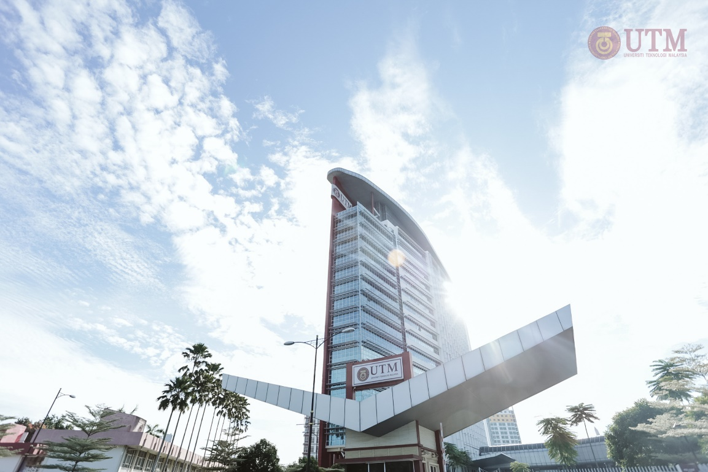
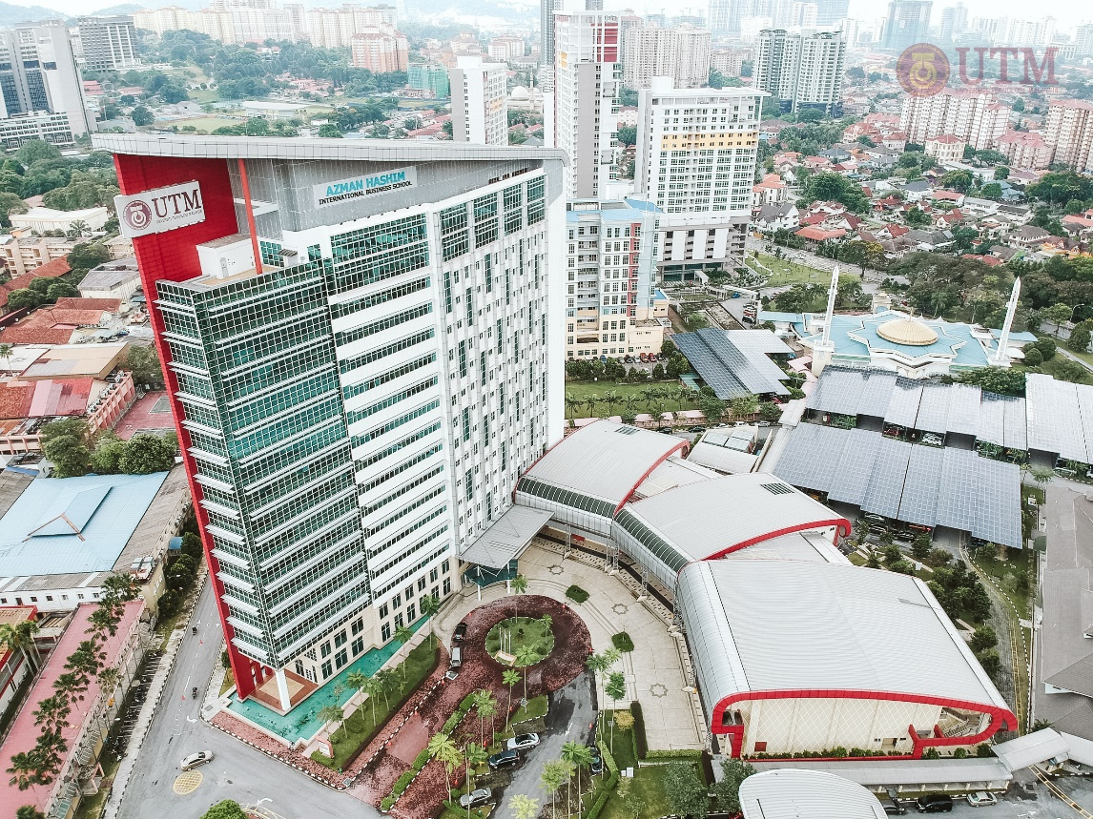
COURSES OFFERED IN FSSHKL
MPhil and PhD programmes (LA)
M Ed. TESL (SoE) – Taught Course and Mixed Mode
PhD TESL
CURRENT STUDENTS: 72
NEW PHD STUDENTS: 7 (LA), 3 (PHD TESL)
NEW MASTER STUDENT: 1
Notes:
https://www.google.com/search?safe=strict&tbs=isz:l&tbm=isch&q=BUSINESSMAN+PNG&spell=1&sa=X&ved=0ahUKEwiZ2J_Bm8rjAhVSAXIKHVruA0QQBQhpKAA&biw=2560&bih=888&dpr=1#imgrc=Rn8EkHZqe8hOTM:

Slide 14
GET IN TOUCH
WhatsApp PG FSSHKL Students: https://chat.whatsapp.com/AqNEYvpFuI8KrXT4voVGp1 (Only for FSSHKL students)
Website: https://humanities.utm.my/kl/
IG: humanities.utmkl
LIST OF EXPERTISE IN KL
https://humanities.utm.my/kl/research-area/
Notes:
https://www.google.com/search?safe=strict&tbs=isz:l&tbm=isch&q=BUSINESSMAN+PNG&spell=1&sa=X&ved=0ahUKEwiZ2J_Bm8rjAhVSAXIKHVruA0QQBQhpKAA&biw=2560&bih=888&dpr=1#imgrc=Rn8EkHZqe8hOTM:

Slide 15
