Slide 1
FSSHKL Postgraduates
New Semester Briefing
SEM 2020/ 2021 (2)
Notes:
Illustration by freepik

Slide 2
Welcoming Session by
Director of FSSHKL

Slide 3
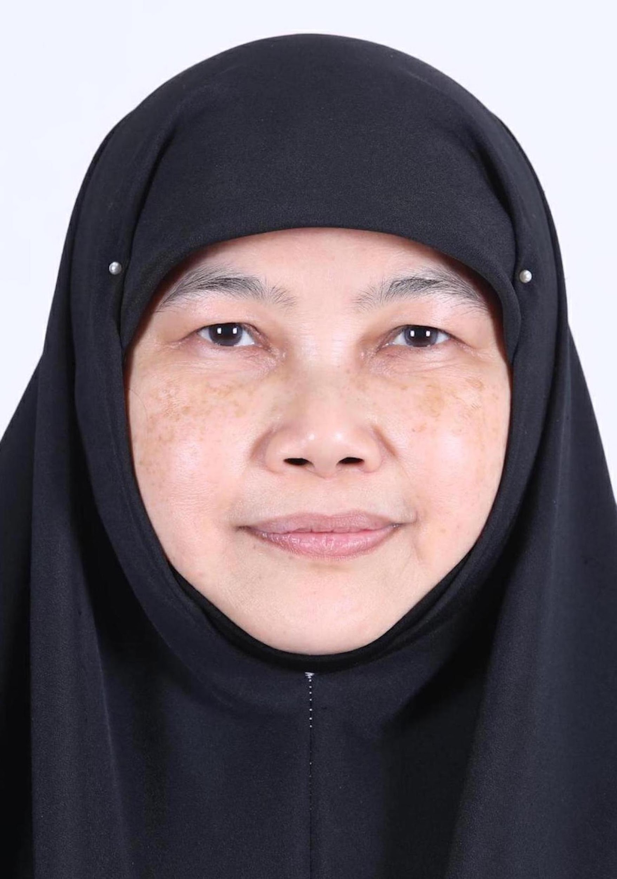
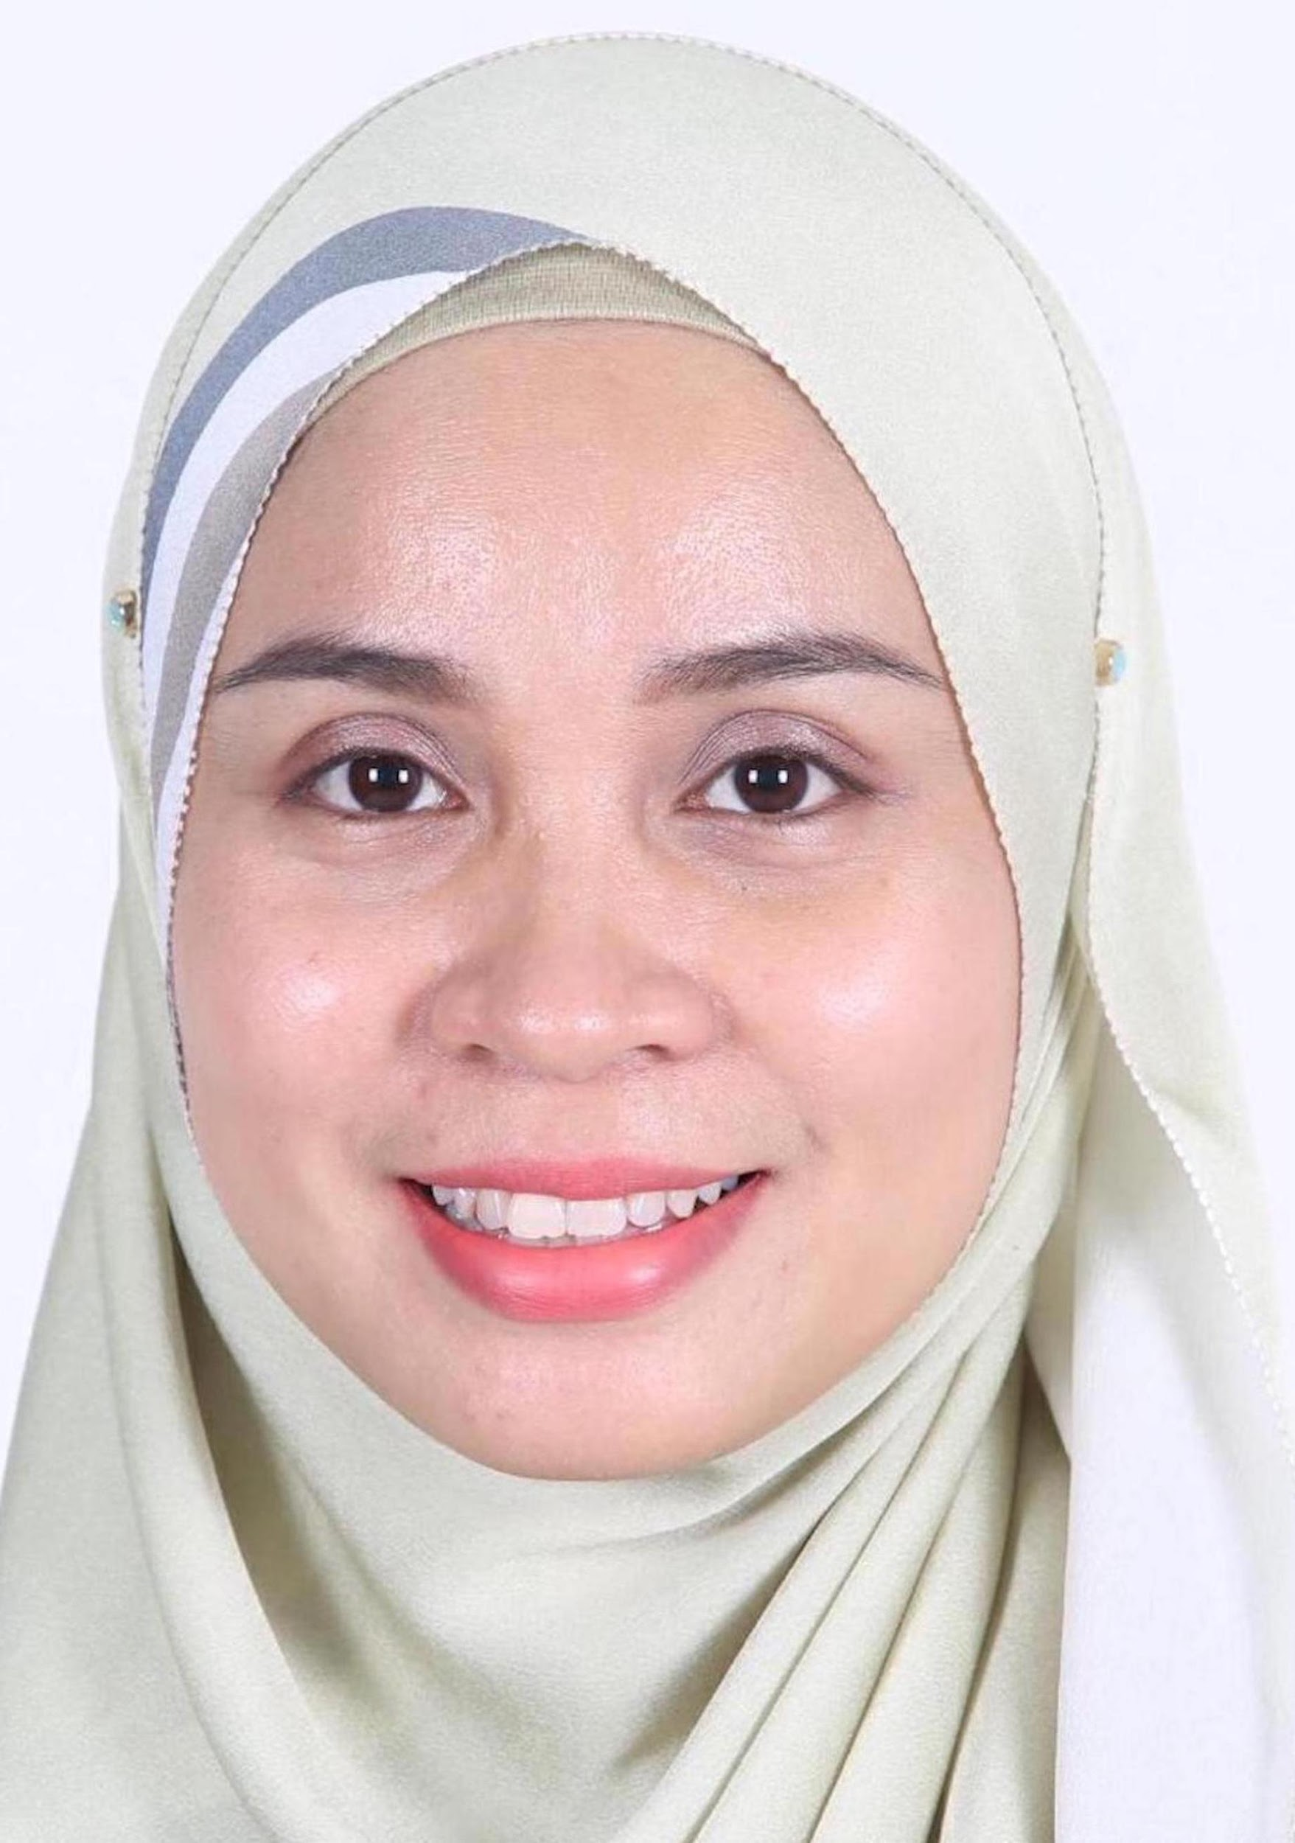
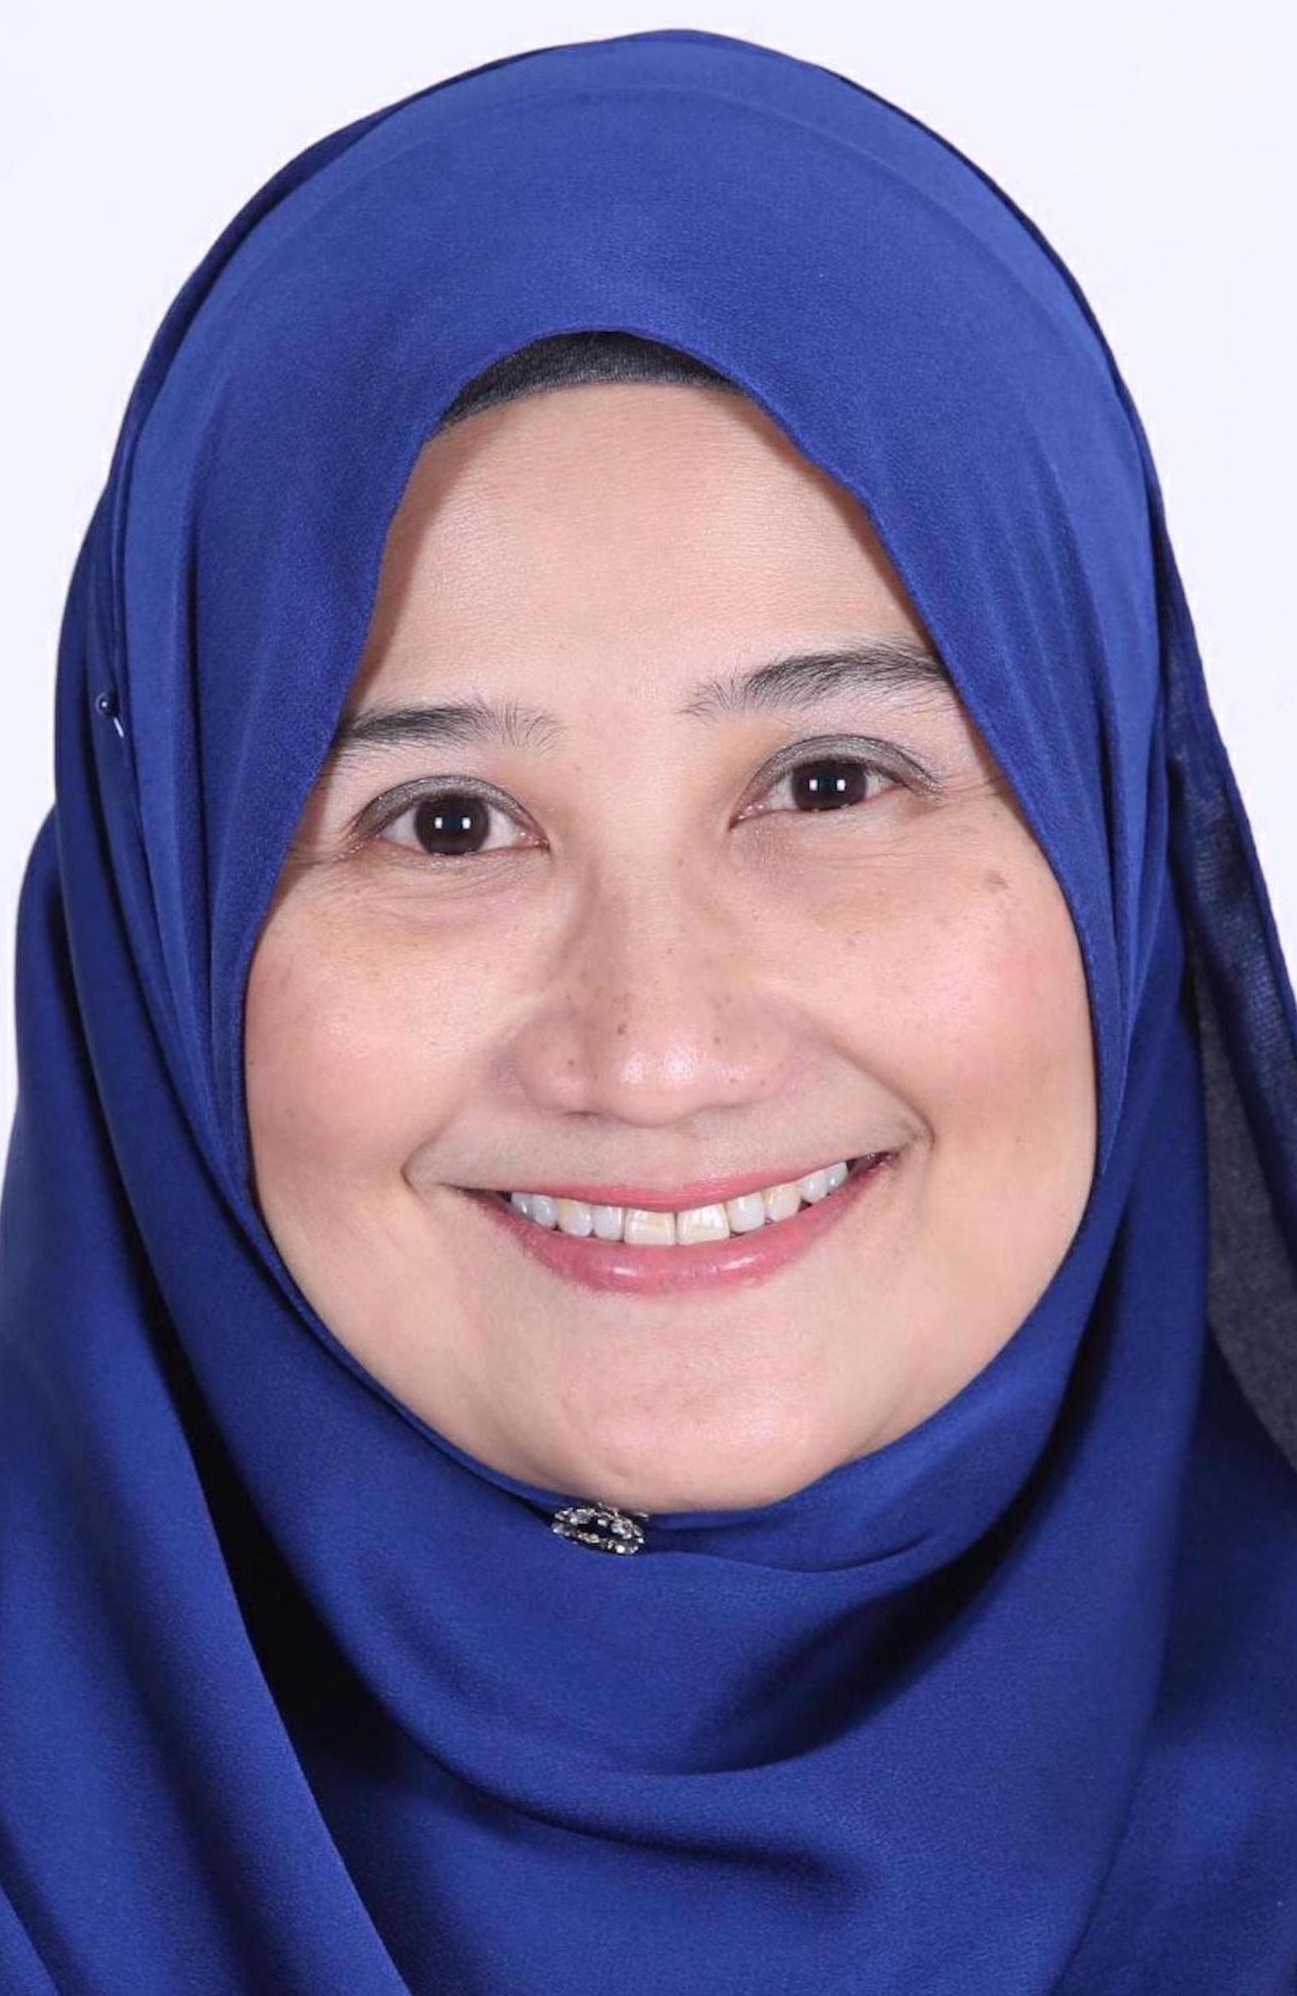
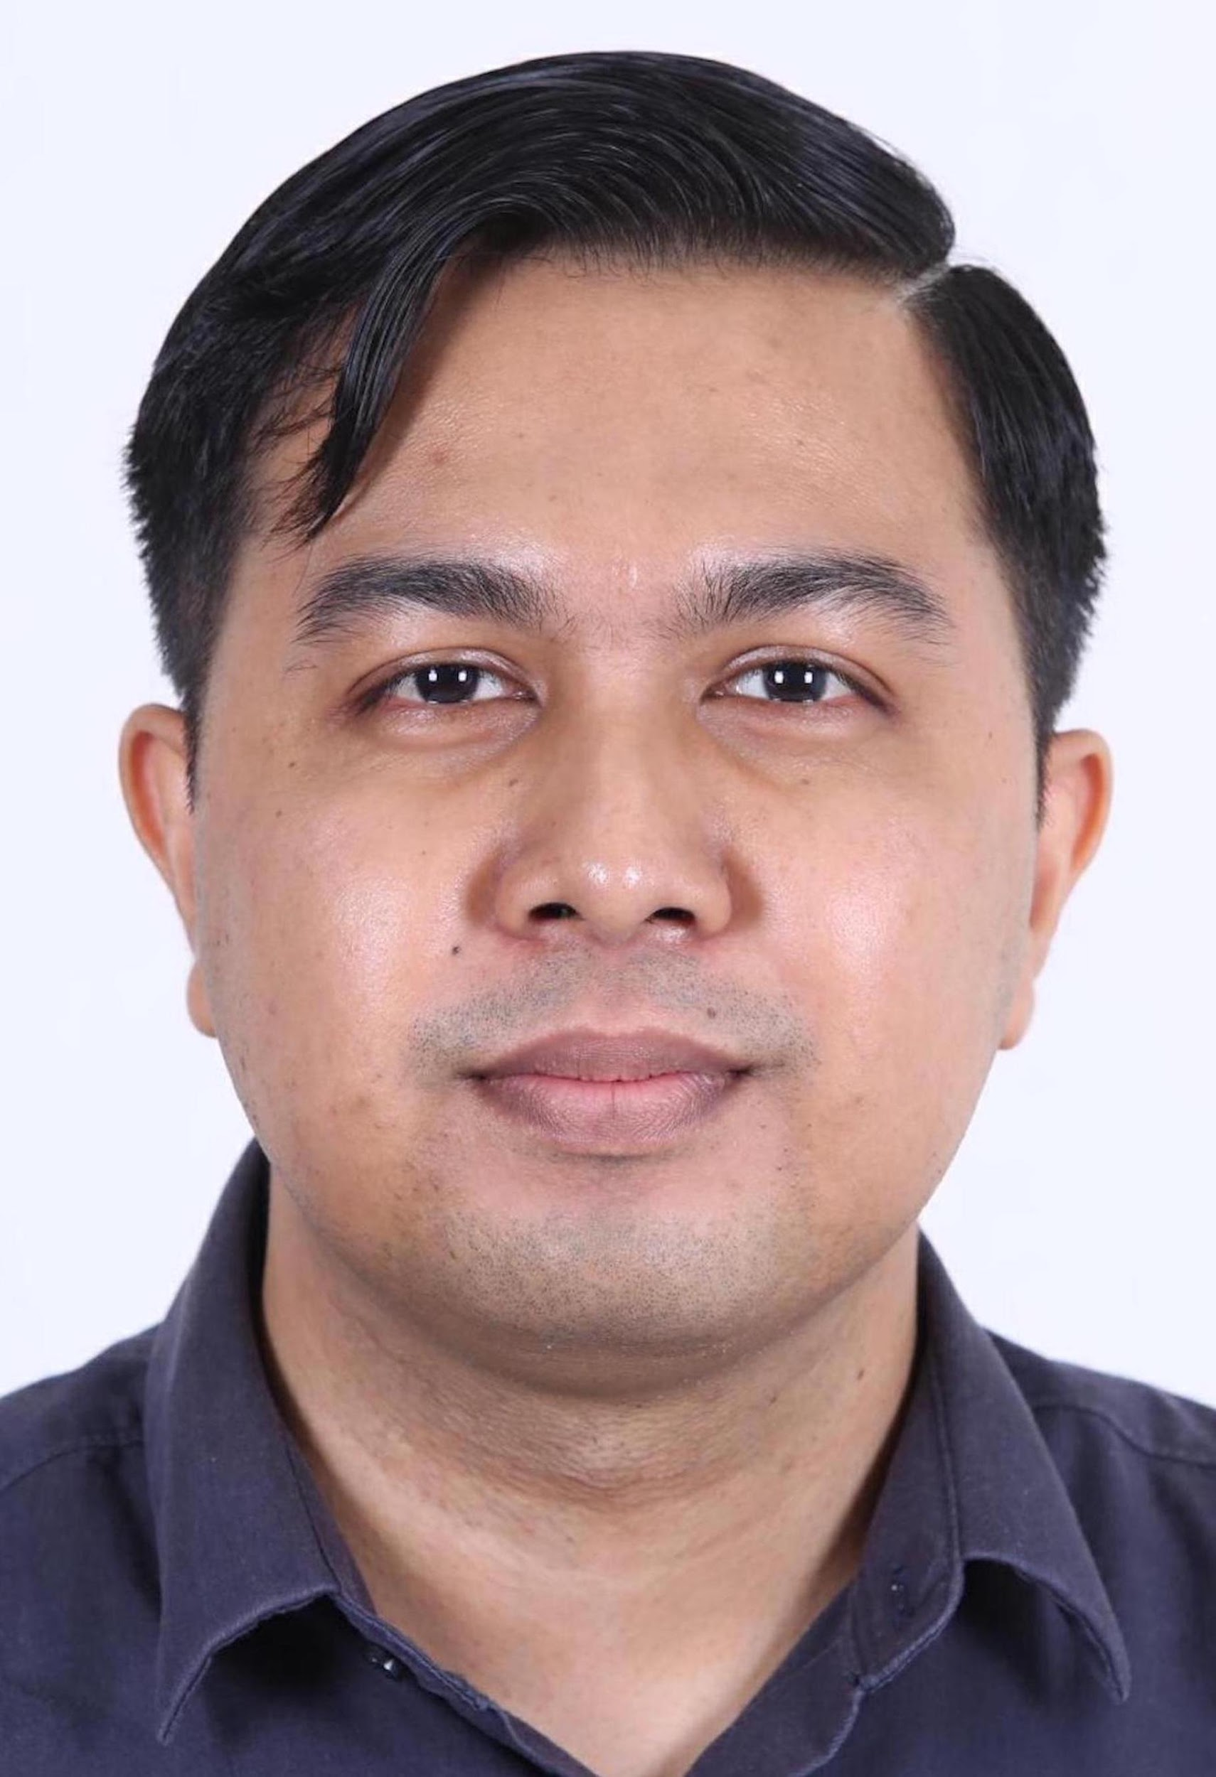
Important Contact Person
Assoc. Prof. Dr Sarimah Shamsudin
Director (Social Sciences and Humanities), FSSHKL
ssarimah.kl@utm.my
Dr Wan Farah Wani Wan Fakhruddin
Language Academy Postgraduate Programme Coordinator
wanfarah@utm.my
Dr Nurhasmiza Abu Hasan Sazalli
TESL Postgraduate Programme Coordinator
nurhasmiza.kl@utm.my
Mr. Muhammad Nadzrin bin Abdullah Mohmmad Suhaimi
Assistant Administrative Officer
nadzrin@utm.my
Notes:
Photo by Christopher Campbellon Unsplash
Photo by Danon Unsplash
Photo by Luis Villasmilon Unsplash
Photo by Lucas Sankeyon Unsplash
Photo by Kelly Sikkemaon Unsplash
Photo by Paul Castaniéon Unsplash
Photo by Content Pixieon Unsplash

Slide 4
Important People You Should Know
LIST OF EXPERTISE IN KL
https://humanities.utm.my/kl/research-area/
LIST OF EXPERTISE IN JB
https://humanities.utm.my/languageacademy/our-experts/
Notes:
Photo by Christopher Campbellon Unsplash
Photo by Danon Unsplash
Photo by Luis Villasmilon Unsplash
Photo by Lucas Sankeyon Unsplash
Photo by Kelly Sikkemaon Unsplash
Photo by Paul Castaniéon Unsplash
Photo by Content Pixieon Unsplash

Slide 5
Important Websites to Refer to
FSSHKL Website
Faculty Website
https://humanities.utm.my/kl/
https://humanities.utm.my
Graduate Studies Management System (GSMS)
SPS Website
https://sps.utm.my/
http://spsapp3.utm.my:8080/gsmsv4/index.jsp
Notes:
Photo by Christopher Campbellon Unsplash
Photo by Danon Unsplash
Photo by Luis Villasmilon Unsplash
Photo by Lucas Sankeyon Unsplash
Photo by Kelly Sikkemaon Unsplash
Photo by Paul Castaniéon Unsplash
Photo by Content Pixieon Unsplash

Slide 6
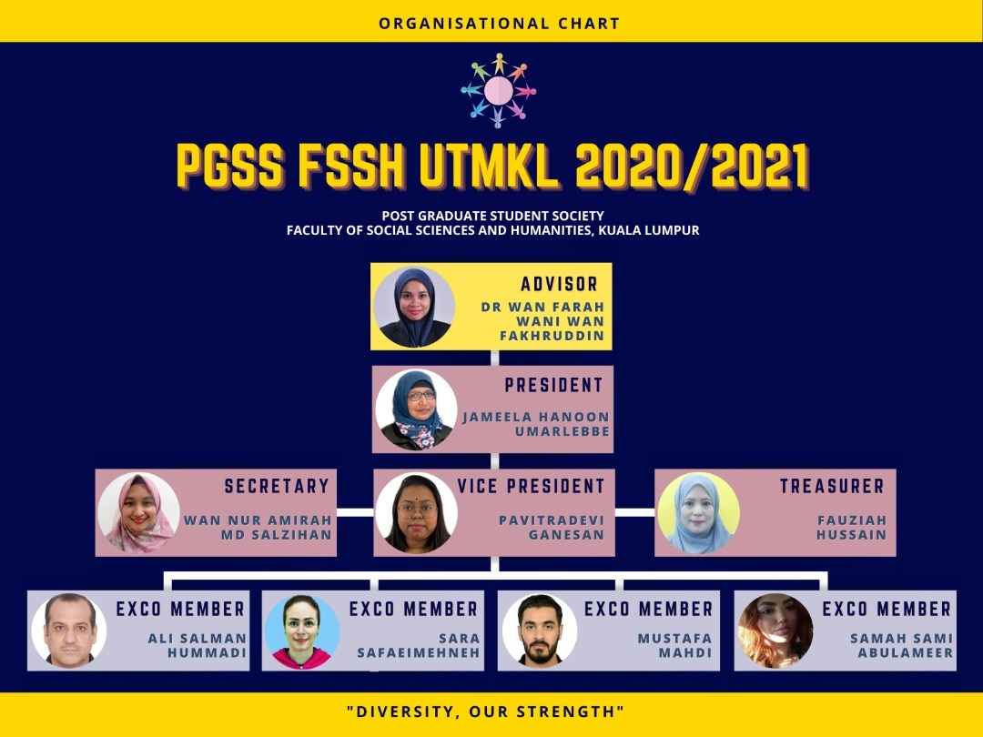
PGSS FSSHKL

Slide 7
Programmes Offered at FSSHKL
TESL Programmes
Language Academy Generic Programmes
Master of Education (TESL) (Taught Course)
Master of Education (TESL) Mixed-mode
Master of Education (TESL) Full Research
Doctor of Philosophy (TESL)
Master of Philosophy
Doctor of Philosophy

Slide 8
TESL Programmes

Slide 9
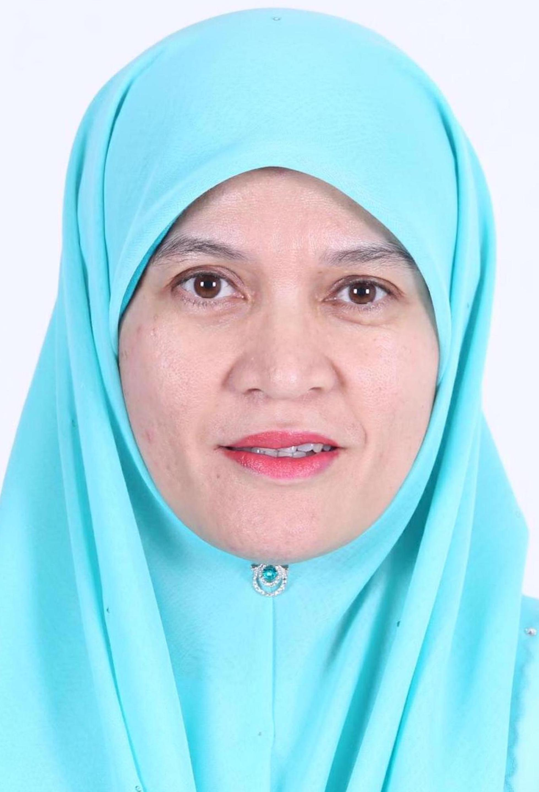
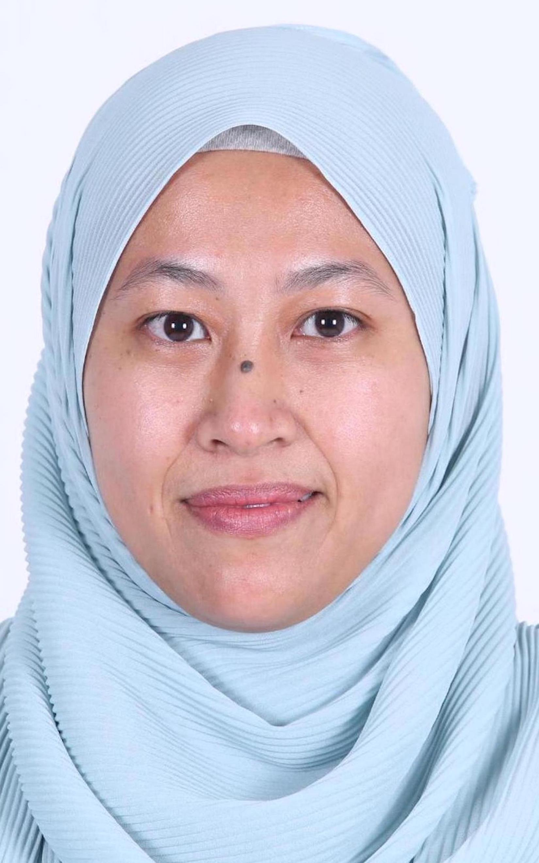
Master TESL KL Lecturers for Sem 2020/2021 (1)
Assoc. Prof. Dr Marlia Puteh
Dr Wan Farah Wani Wan Fakhruddin
Seminar I Tuesday 9-12pm
marlia.kl@utm.my
Innovation in Teaching & Learning I Monday 4-7pm
Description of English I Wednesday 9-12pm
wanfarah@utm.my
Dr Wan Nur Asyura Wan Adnan
Dr Nurhasmiza Abu Hasan Sazalli
Structure of English I Friday 4-7pm
Language Learning Theory I Saturday 9-12pm
asyura.kl@utm.my
Computer Assisted Lang. Learning I Friday 9-12pm
Second Language Acquisition I Sunday 9-12pm
nurhasmiza.kl@utm.my
Notes:
Photo by Christopher Campbellon Unsplash
Photo by Danon Unsplash
Photo by Luis Villasmilon Unsplash
Photo by Lucas Sankeyon Unsplash
Photo by Kelly Sikkemaon Unsplash
Photo by Paul Castaniéon Unsplash
Photo by Content Pixieon Unsplash

Slide 10
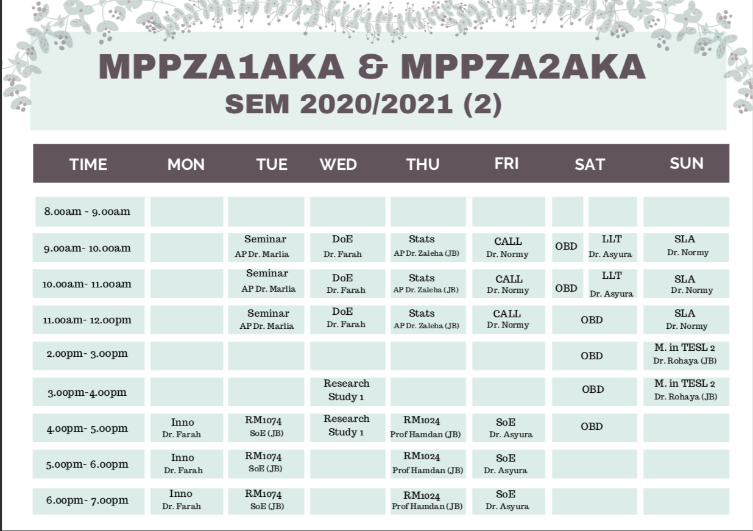
Class
Timetable
For Sem 2020/2021 (2), all classes are conducted online.
Please contact the respective lecturers to get their Webex link.

Slide 11
M.Ed (TESL):
Taught Course (MPPZA1AKA)

Slide 12
University Electives (3 credits)
Choose any 1 (one)
UBSE 1123/ UBSS 6013 Organisation Behavior and Development
MBSA 1533/UBSS 6023 Business Ethics, Responsibility and Sustainability
UPPF 6033/ UHPS 6013 Dynamics of Leadership
For for more choices & info, refer to:
https://sps.utm.my/academic-related-resources/

Slide 13
Faculty Compulsory Courses
(11 Credits)
MPPU 1024 Research Methods in Education
MPPU 1034 Application of Statistics in Educational 1
MPPU 1003 Innovation on Learning and Teaching
For Sem 2020/2021 (2), KL students are to register and join the online classes conducted by School of Education, JB for MPPU 1024 & MPPU 1034 courses.
MPPU 1003 is offered in FSSH KL, so KL students are to register and join the class conducted by FSSH KL.

Slide 14
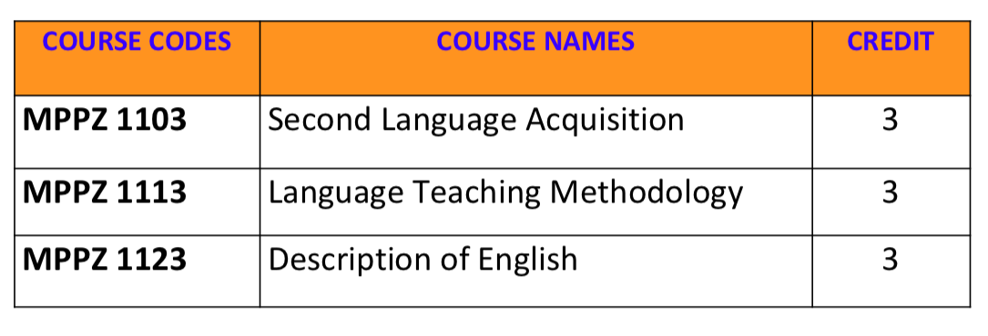
Programme Specialisation (3 Core)

Slide 16
Students must present their Research Project proposal orally to one (1) internal examiner by the 2nd Semester/ latest 3rd Semester. Viva voce after completion of project is not required.

Slide 17
M.Ed (TESL):
Mixed Mode (MPPZA2AKA)

Slide 18
University Electives (3 credits)
Choose any 1 (one)
UBSE 1123/ UBSS 6013 Organisation Behavior and Development
MBSA 1533/UBSS 6023 Business Ethics, Responsibility and Sustainability
UPPF 6033/ UHPS 6013 Dynamics of Leadership
For for more choices & info, refer to:
https://sps.utm.my/academic-related-resources/

Slide 19
Faculty Compulsory Courses
(7 Credits)
MPPU 1074 Research Methodology and Data Analyses in Education
MPPU 1003 Innovation on Learning and Teaching
For Sem 2020/2021 (2), KL students are to register and join the online classes conducted by School of Education, JB for MPPU 1074.
MPPU 1003 is offered in FSSH KL, so KL students are to register and join the class conducted by FSSH KL.

Slide 20
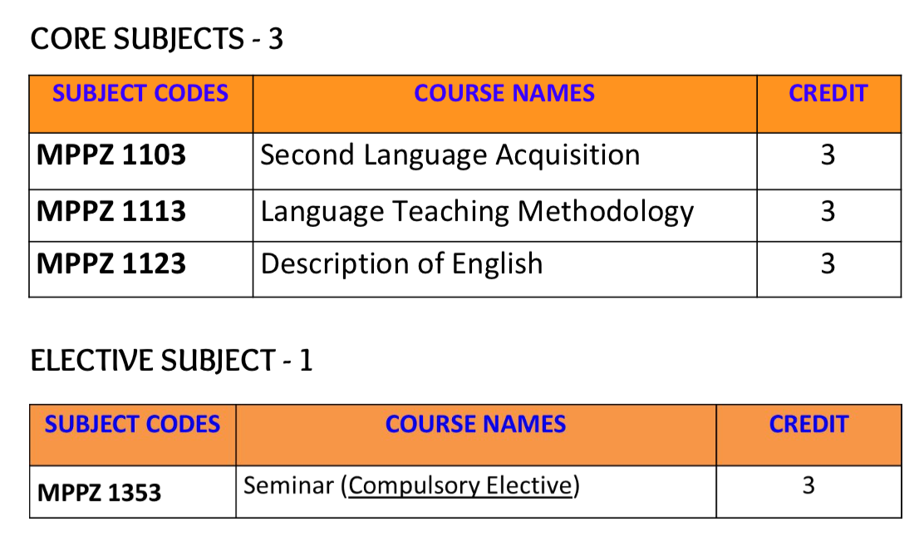
Programme Specialisation
(12 credits)

Slide 21
Dissertation (23 Credits)
Dissertation is to be registered during the second semester onwards, after completing other courses.
Students need to refer to Dissertation Code guideline every semester when registering.
Students must submit their Progress Report via GSMS every semester starting from the semester they register for dissertation.
Students must present their dissertation proposal orally to two (2) internal examiners by the 2nd Semester/ latest 3rd Semester
Students must sit for viva-voce after completing their dissertation.

Slide 22
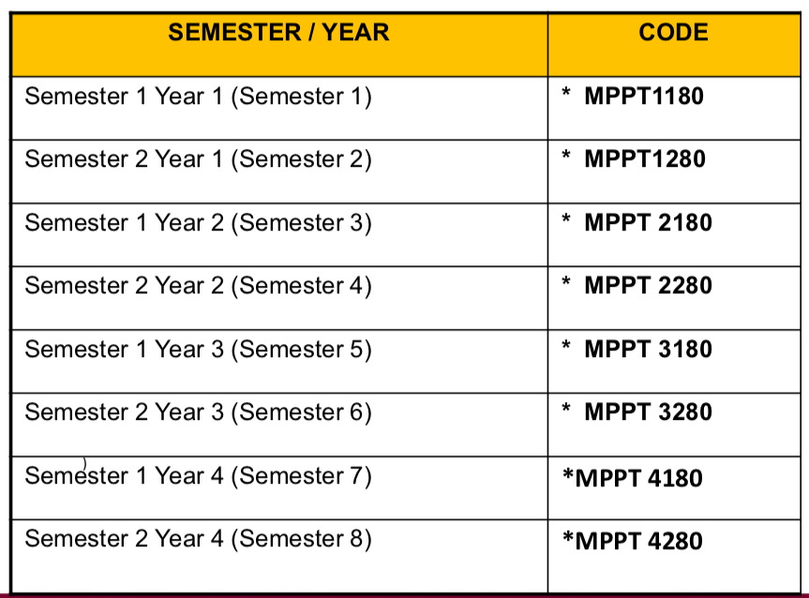
Dissertation Code

Slide 23
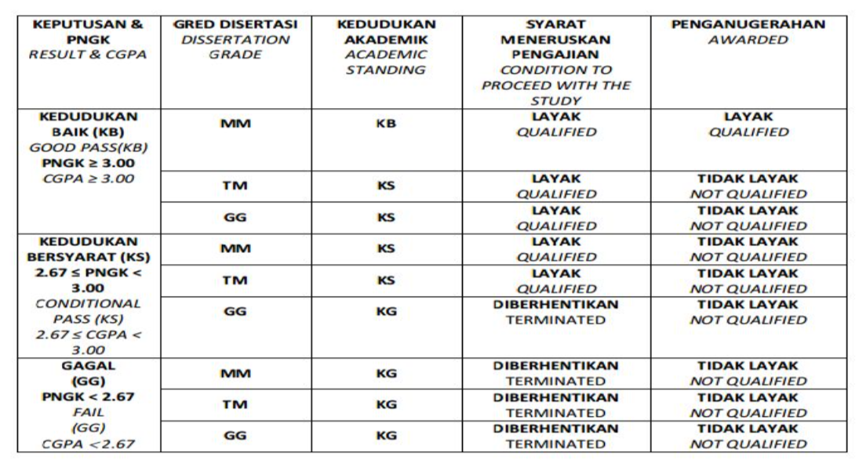
Grading System for Mixed Mode

Slide 24
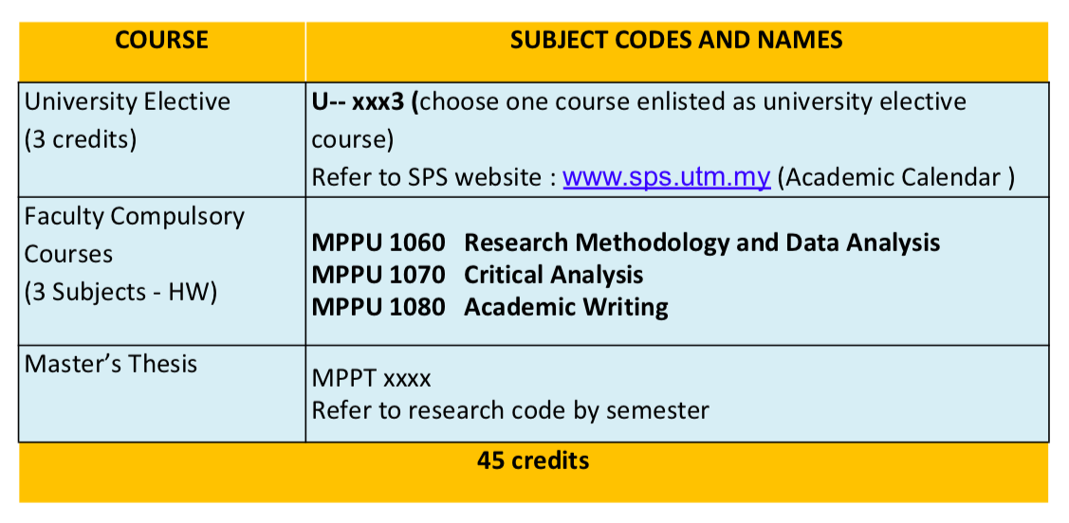
M.Ed (TESL):
Full Research (MPPZA3AKA)

Slide 25
University Electives (3 credits)
Choose any 1 (one)
UBSE 1123/ UBSS 6013 Organisation Behavior and Development
MBSA 1533/UBSS 6023 Business Ethics, Responsibility and Sustainability
UPPF 6033/ UHPS 6013 Dynamics of Leadership
For for more choices & info, refer to:
https://sps.utm.my/academic-related-resources/

Slide 26
Faculty Compulsory Courses (7 Credits)
MPPU 1060 Research Methodology and Data Analysis
MPPU 1070 Critical Analysis
MPPU 1080 Academic Writing
For Sem 2020/2021 (2), all classes are conducted online by School of Education, JB so KL students are to register and join all the classes there.

Slide 27
Master Thesis
Students need register the right research code every semester, starting from the first semester.
Students must submit their Progress Report via GSMS every semester, reporting their research and writing progress.
Students must present their thesis proposal orally to two (2) internal examiners by the 2nd Semester/ latest 3rd Semester.
Students must submit the NOTICE FOR THESIS SUBMISSION three (3) months prior to thesis submission.
Students must sit for viva-voce (1 internal examiner, 1 external examiner) after submitting their thesis.

Slide 28
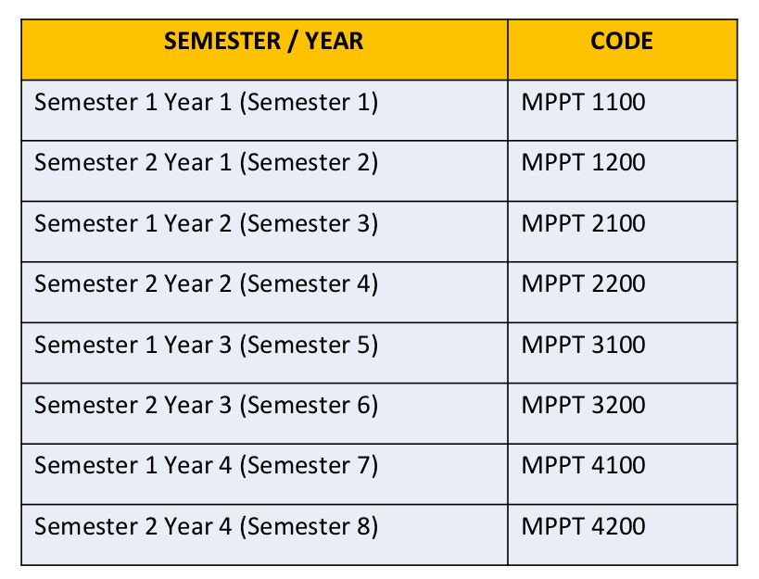
Master Thesis Code

Slide 29
Grading System for Mixed Mode

Slide 30
Pre-Requisite Course
Students who do not have background in education and TESL can still enroll in the Master in Education (TESL) programme.
They just need to take the following courses before registering for the Programme Specialisation courses:
1. LPPP 1113 Structure of English
2. LPPP 1123 Language Learning Theories
3. LPPP1133 Methodology in TESL II
For Sem 2020/2021 (2), all pre-requisite courses are offered at FSSH KL except for LPPP 1133.

Slide 31
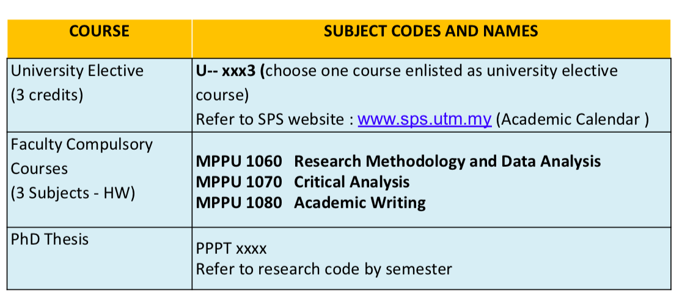
Doctor of Philosophy (TESL):
Full Research (PPPZA3AKA)

Slide 32
University Electives (3 credits)
Choose any 1 (one)
UBSE 1123/ UBSS 6013 Organisation Behavior and Development
MBSA 1533/UBSS 6023 Business Ethics, Responsibility and Sustainability
UPPF 6033/ UHPS 6013 Dynamics of Leadership
For for more choices & info, refer to:
https://sps.utm.my/academic-related-resources/

Slide 33
Faculty Compulsory Courses (7 Credits)
MPPU 1060 Research Methodology and Data Analysis
MPPU 1070 Critical Analysis
MPPU 1080 Academic Writing
For Sem 2020/2021 (2), all classes are conducted online by School of Education, JB so KL students are to register and join all the classes there.

Slide 34
PhD Thesis
Students need register the right research code every semester, starting from the first semester.
Students must submit their Progress Report via GSMS every semester, reporting their research and writing progress.
Students must present their thesis proposal orally to two (2) internal examiners by the 2nd Semester/ latest 3rd Semester.
Students must submit the NOTICE FOR THESIS SUBMISSION three (3) months prior to thesis submission.
Students must sit for viva-voce (1 internal examiner, 1 or 2 external examiner) after submitting their thesis.

Slide 35
Publication Requirement for PhD in TESL
Normal thesis submission (6th semester onwards)
One (1) journal article indexed in Web of Science (WOS) or 2 articles indexed in Scopus/ ERA/ MyJournal
Early thesis submission (5th semester)
Two (2) journal articles indexed in WOS/ Scopus/ ERA

Slide 36
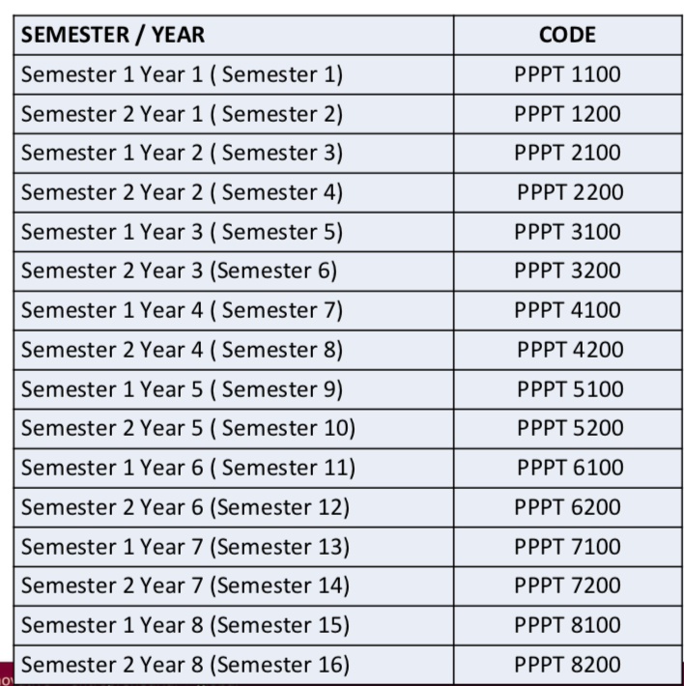
PhD Thesis
Code

Slide 37
Language Academy Programmes

Slide 38
KEY RESEARCH AREAS
Applied Linguistics
Language
Communication
Multimodality
Sociolinguistics
Discourse Analysis
Genre Analysis
Corpus Linguistics
Critical Discourse Analysis
Education policy
Language Training
English for Specific Purposes (ESP)
Multimodality
Translation
Computer-mediated communication
Mobile learning
Cultural and intercultural communication
Media and Global Communication
Health Communication
Professional Communication

Slide 39
Master of Philosophy
Doctor of Philosophy
Full research programme
Minimum 3 semesters, maximum 8 semesters
Admission is open throughout the year
Full research programme
Minimum 6 semesters, maximum 16 semesters
Admission is open throughout the year

Slide 40
Students need to complete…
ONE University General Course
Refer to https://sps.utm.my/academic-related-resources/
FSSH Compulsory Course
(ULAP 0010 Research Methodology)
Offered only in first semester of academic year
Thesis (MUST REGISTER EVERY SEMESTER)
Refer to https://humanities.utm.my/kl/study-plan/
Notes:
Photo by Maarten Wijnantson Unsplash Illustration by freepik

Slide 41
To graduate, you MUST…
Attend all required courses
Submit progress report to GSMS every semester – must get MM (Satisfactory) result
Submit thesis
Publish at least 1 indexed article / 2 indexed conference proceedings (SCOPUS/ ERA/ WOS)
Notes:
Photo by Maarten Wijnantson Unsplash Illustration by freepik

Slide 42
Commonly Used Acronym
MM – Satisfactory
TM – Unsatisfactory
TD – Withdraw
UM – Repeat Course
HL – Hadir Lulus / Pass
HG – Fail
HW – Hadir Wajib / Compulsory

Slide 43
Your Research Journey

Slide 44
Research Study Journey
Sem 3

Slide 45
1st Assessment for Research
Students MUST complete the University general course and Research Methodology (ULAP0010) before being allowed to defend their proposal (effective Sem I 2017/2018).

Slide 47
Students who MUST present this semester
Abdullah Saddam Abood Abdulneby
Ainuska Tashbaeva
Mustafa Mahdi Jubier Jubier
Sara Safaeimehneh
Xu Leilei
Anwar Yusara
Bashar Jadah Farhan Alomairi
Asma Abdullah F. Alasbali
Maytham Hashim Mutlag Mutlag
Jameela Hanoon Umarlebbe
Muhammad Riaz Khan
Muhammad Ashfaq
Mohd Razwan Bin Zulkafli

Slide 48
Proposal Requirement
Students must complete all compulsory courses (Research Methodology and University Elective Course)
Students who need to submit their proposals in Sem II 2020/2021 but have not finished the courses must enrol for the courses in the same semester
The average number of pages are between 30 and 40 pages
The proposal must reflect the level of study and student’s programme (niche area) – originality and contribution to knowledge
The proposal must follow the UTM format of academic writing.

Slide 49
Elements Covered in the Proposal Assessment Report
Title of research proposal
Research Problem
Research Objectives and Research Questions
Scope of the Research
Significance of the Study
Literature Review
Methodology / Materials/ Design/ Methods

Slide 50
Thesis Examiner Appointment
Degree | Examiner Nomination | Internal Examiner | External Examiner
M Ed TESL (Taught Course) | 3 Internal Examiner | 1 | -
M Ed TESL (Mixed Mode) | 3 Internal Examiner | 2 | -
Master (non UTM staff) | 3 Internal Examiner, 3 external examiner | 1 | 1
Master (UTM staff) | 3 Internal Examiner, 4 external examiner | 1 | 2
PhD (non UTM staff) | 3 Internal Examiner, 3 external examiner | 1 | 1
PhD (UTM staff) | 3 Internal Examiner, 4 external examiner | 1 | 2

Slide 51
VIVA Process
Students register research code for current semester
Thesis format review
Viva voce fee payment
PASS the Research Methodology and University Course
Publication verification check
NHT verification check
No outstanding fee
Submit thesis to faculty for VIVA
(4 copies for students/
5 copies for UTM Staff)
Faculty submit thesis submission form to SPS to change status from A (Active) to V (Examination) in AIMS
Faculty submit thesis to examiner for thesis evaluation
Faculty receive REPORT / thesis evaluation and arrange VIVA date
Faculty to arrange accommodation for external examiner, transportation, etc
(if necessary)
VIVA-VOCE
VIVA Fees
(intake 2016/2017 onwards)
PhD: RM 2500
Master: RM 1500

Slide 52
Publication Requirement

Slide 53
New Publication Requirement (Sem I 2020/2021 intake)
Normal thesis submission (6th semester onwards)
1 journal article indexed in Web of Science (WOS) or 2 articles indexed in Scopus/ ERA/ MyJournal
Early thesis submission (5th semester)
2 journal articles indexed in WOS/ Scopus/ ERA

Slide 54
Examination Result and Correction Period
Three (3) weeks
Three (3) weeks
Three (3) months
One (1) month
Six (6) months
Three (3) months
Twelve (12) months
Six (6) months
Twelve (12) months / Reviva
Six (6) months / Reviva
Awarded a lower degree
Not awarded a degree
Not awarded a degree
Resubmission Fee:
PhD: RM 2000 Master: RM 1000

Slide 55
Important Dates for Sem II 2020/2021

Slide 56
Upcoming programmes
Virtual Coffee sessions
(Once every two months)
Ask Me Anything sessions
(Once every two months)
PhD Journey Stories
(Once a month)
Notes:
Photo by Maarten Wijnantson Unsplash Illustration by freepik

Slide 57
Upcoming conferences
Lancaster Linguistics and English Language Postgraduate Conference
(Abstract submission deadline: Friday, 26 March 2021)
Conference date: 23-24 July 2021
Virtual Language and Communication Postgraduate International Seminar (VLCPIS)
Conference date: TBA
International Professional Doctoral & Postgraduate Symposium (iPDOCs) 2021
Conference date: 25 September 2021
Notes:
Photo by Maarten Wijnantson Unsplash Illustration by freepik

Slide 58
Meet Your Supervisor / Examiner

Slide 59
Thank You
Question & Answer Session
Notes:
Illustration by freepik

